Slide 1

Introduction to HTML/CSS
r

Slide 2
An Introduction to
HTML

Slide 3
Agenda
Semantic Tags in HTML
HTML form and requirement
Form Elements
Input Types
Attributes
New proposed HTML form Tags

Slide 4
Semantic Tags in HTML
Tags or elements in HTML, which focuses on meaning of the webpage rather than just presentation of it.
Semantic HTML tags provide information about the contents of those tags that goes beyond just how they look on a page. Text that is enclosed in the <code> tag is immediately recognized by the browser as some type of coding language.

Slide 5
Semantic Tags in HTML
Existing Semantic HTML tags:
<abbr>,<acronym>,<blockquote>,<dfn>,<address>,<cite>,<code>,<sub>,<sup>,
<strong>
New Semantic tags in HTML5:
<footer>,<header>,<article>,<section>,<main>,<nav>,<figcaption>,<figure>,<mark>,
<aside>
For More info :
https://www.lifewire.com/why-use-semantic-html-3468271
https://www.w3schools.com/Html/html5_semantic_elements.asp

Slide 6
HTML form and requirements
HTML forms are used for carrying and communicating data from one page to another in a web application.
<form action = "Script URL" method = "GET|POST"> form elements like input, textarea etc. </form>

Slide 7
Form Elements
Input Element:
<input type="text" name="firstname" value=””>
Radio Button:
<form>
<input type="radio" name="gender" value="male" checked> Male<br>
<input type="radio" name="gender" value="female"> Female<br>
<input type="radio" name="gender" value="other"> Other
</form>
checkbox:
<input type="checkbox" name="vehicle1" value="Bike"> I have a bike<br>
<input type="checkbox" name="vehicle2" value="Car"> I have a car<br>
<input type="checkbox" name="vehicle3" value="Boat" checked> I have a boat<br>

Slide 8
Form Elements
Select Element:
<select name="cars">
<option value="volvo">Volvo</option>
<option value="saab">Saab</option>
<option value="fiat">Fiat</option>
<option value="audi">Audi</option>
</select>
File type:
<input type="file" name="myFile">
Submit Button:
<input type="submit" /> OR <button type="submit"> </button>

Slide 9
Form Elements
TextArea
<textarea rows="4" cols="50">
This is large textArea
</textarea>
Label
<form action="/action_page.php">
<label for="male">Male</label>
<input type="radio" name="gender" id="male" value="male"><br>
<label for="female">Female</label>
<input type="radio" name="gender" id="female" value="female"><br>
<label for="other">Other</label>
<input type="radio" name="gender" id="other" value="other"><br><br>
<input type="submit" value="Submit">
</form>

Slide 10
Input Types
Password
<input type="password" name="psw">
Email
<input type="email" value="abc@gmail.com">
Number
<input type="email" value="abc@gmail.com">
Several Others:
Color , date , datetime-local ,month, range, search, tel, time, url, week

Slide 11
Form Attributes
value Attribute
<input type="text" name="firstname" value="John">
Readonly Attribute
<input type="text" name="firstname" value="John" readonly>
Disabled Attribute
<input type="text" name="firstname" value="John" disabled>
Size Attribute
<input type="text" name="firstname" value="John" size=”40”>

Slide 12
Form Attributes
Several Others
Autocomplete , autofocus ,form ,formaction ,formenctype ,formmethod ,formnovalidate ,formtarget ,height and width ,min and max ,multiple ,pattern (regexp) ,placeholder ,required ,step

Slide 13
New Proposed Form Tags
DataList
<input list="browsers">
<datalist id="browsers">
<option value="Internet Explorer">
<option value="Firefox">
<option value="Chrome">
<option value="Opera">
<option value="Safari">
</datalist>

Slide 14
New Proposed Form Tags
Output
<form oninput="x.value=parseInt(a.value)+parseInt(b.value)">0
<input type="range" id="a" value="50">100
+<input type="number" id="b" value="50">
=<output name="x" for="a b"></output>
</form>

Slide 15
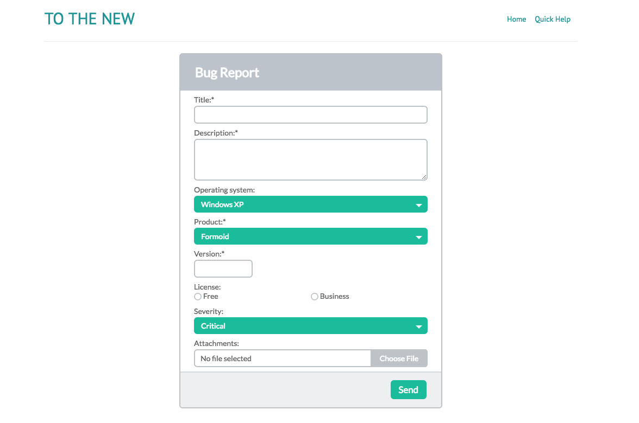
ASSIGNMENT
Please create the following form using required html5 form tags.

